Slide 1



Frito Lays DDSANALYTICS
Stephanie Duarte

Slide 2
Overview
DDS Analytics is an analytics company that specializes in talent management solutions for Fortune 100 companies.
Employee turn over is one if the biggest issues happening across companies.
We will be presenting the top factors that contribute to turnover.

Slide 3
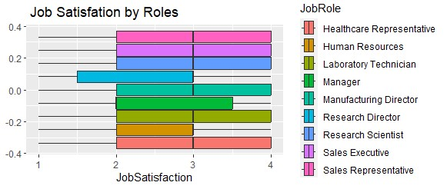
Data Analysis- Job Satisfaction
3

Slide 4
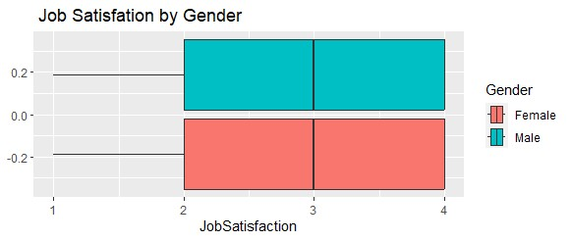
Data Analysis- Job Satisfaction

Slide 5
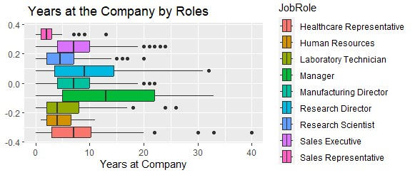
Data Analysis- Years at Company
5

Slide 6
Attrition - Best Model
Parameters: Age, Job Level, Monthly Income and Years at Company
Naïve Bayes
Accuracy | Sensitivity | Specificity
0.8218 | 0.8662 | 0.4118

Slide 7
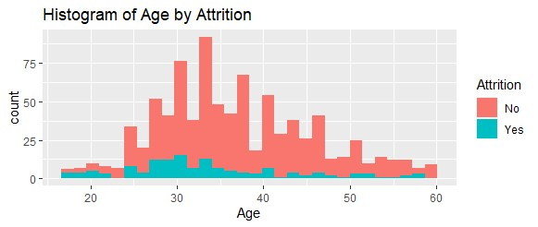
Attrition- Age
7

Slide 8
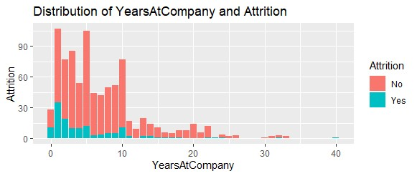
Attrition- Years at Company

Slide 9
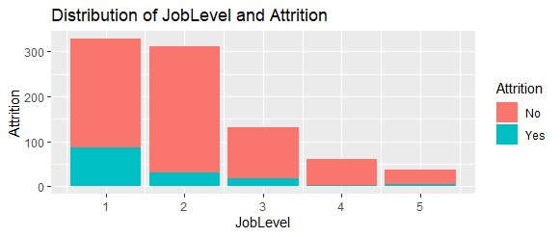
Attrition- Job Level

Slide 10
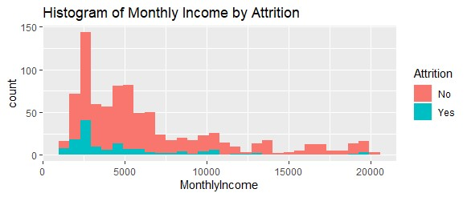
Attrition- Monthly Income

Slide 11
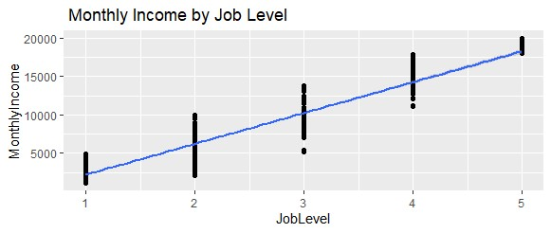
Salary – Job Level
Correlation
0.95164

Slide 12
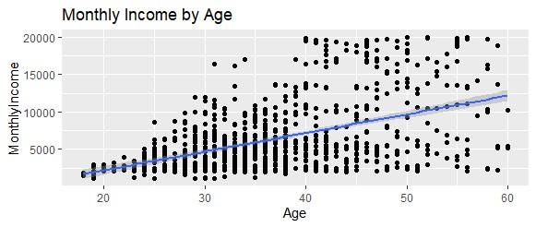
Salary – Age
Correlation
0.48428

Slide 13
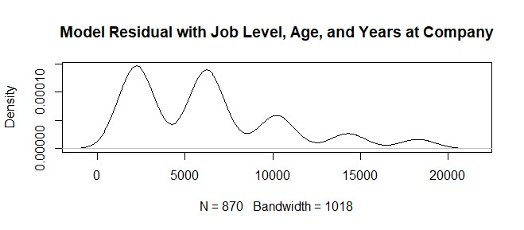
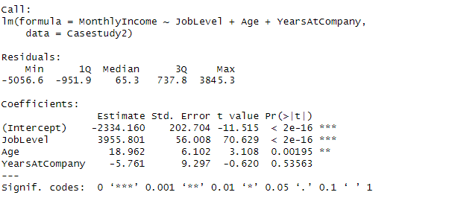
Salary Model
RMSE
1403.698

Slide 14





Thank you!
Stephanie Duarte
duartes@mail.smu.edu

